Slide 1
contents
Creating safety environment
Input
Introduction
Practice
Creating emotion
Evaluation
Learning outcome
Task
Declaration of the lesson
Closing of the class

Slide 2


W
e
m
e
l
c
o

Slide 3
I
ntroduction
Prepared by
Lesson’s identity
Class-Three
Subject-English
Unit-10, Lesson-3
My mother
Time- 45 minutes.
Mahfuz Ara Sultana
Assistant Teacher
Carmaichael College Govt. Primary School,
Sadar, Rangpur

Slide 4
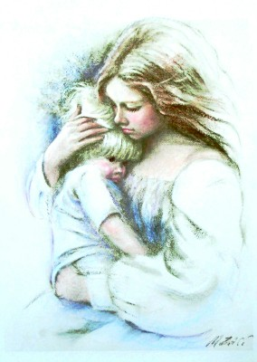
Creating emotion
What do you think about your mother?

Slide 5
Learning outcome
based on competencies
Student will be able to-
1.repeat rhyme after the teacher and recite.
2.read aloud the rhyme with proper pronunciation and stress.
3.recognize punctuation marks and read accordingly.
4.write the rhyme by using punctuation
marks.

Slide 6
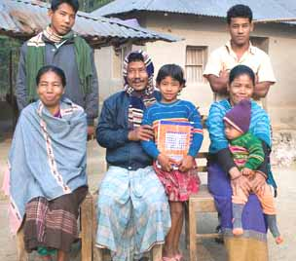
What do you see in the picture?
Whom loved and care you most in your family?
A family

Slide 7
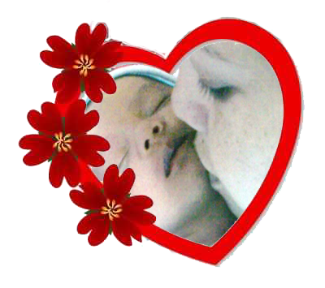
Today’s Lesson
My
mother

Slide 8

Input

Slide 9
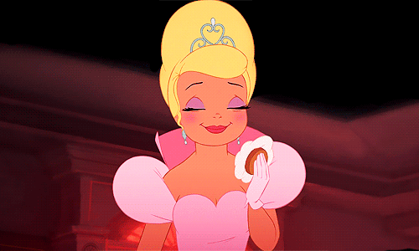
Word meaning, make sentence and pronunciation with appropriate stress and intonation.
Lovely
beautiful.
She has a lovely face .

Slide 10
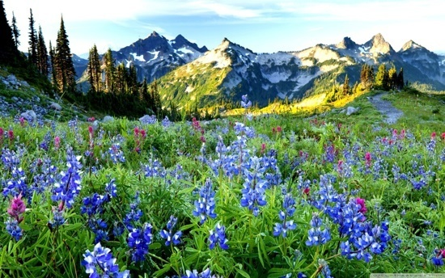
Word meaning, make sentence and pronunciation with appropriate stress and intonation.
Beauty
The quality of being pleasing to the mind.
Look at the beauty of the place .

Slide 11
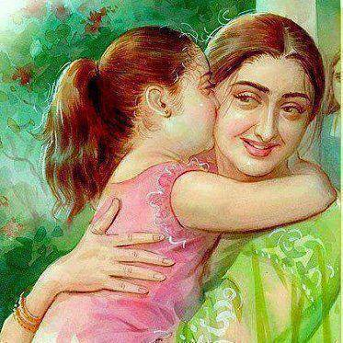
Word meaning, make sentence and pronunciation with appropriate stress and intonation.
Grace
The quality of behavior of polite and pleasant and deserves respect.
I love my mother for her grace.

Slide 12
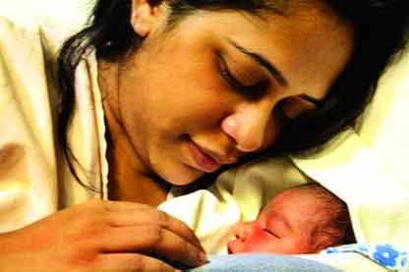
Read the rhyme with the help of picture
A lovely face
I know a face,

Slide 13
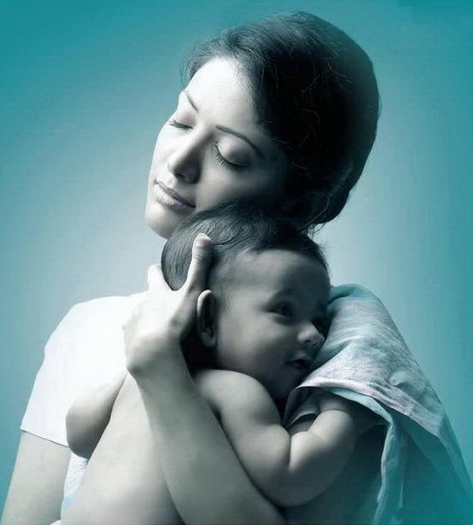
Read the rhyme with the help of picture
As of grace.
So full of beauty,

Slide 14
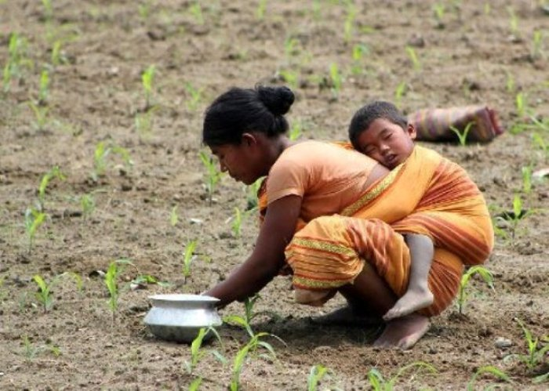
Read the rhyme with the help of picture
Compared no other
That face can be

Slide 15
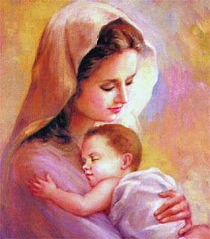
Read the rhyme with the help of picture
Is my beloved mother.
That lovely lady

Slide 16
Look at the punctuation mark.
Look at the capital letter.
Let’s read the rhyme
I know a face,
A lovely face
So full of beauty,
As a grace.
That face can be
Compared to no other
That lovely lady
Is my beloved mother.
I
,
A
S
,
A
.
T
C
T
I
.

Slide 17
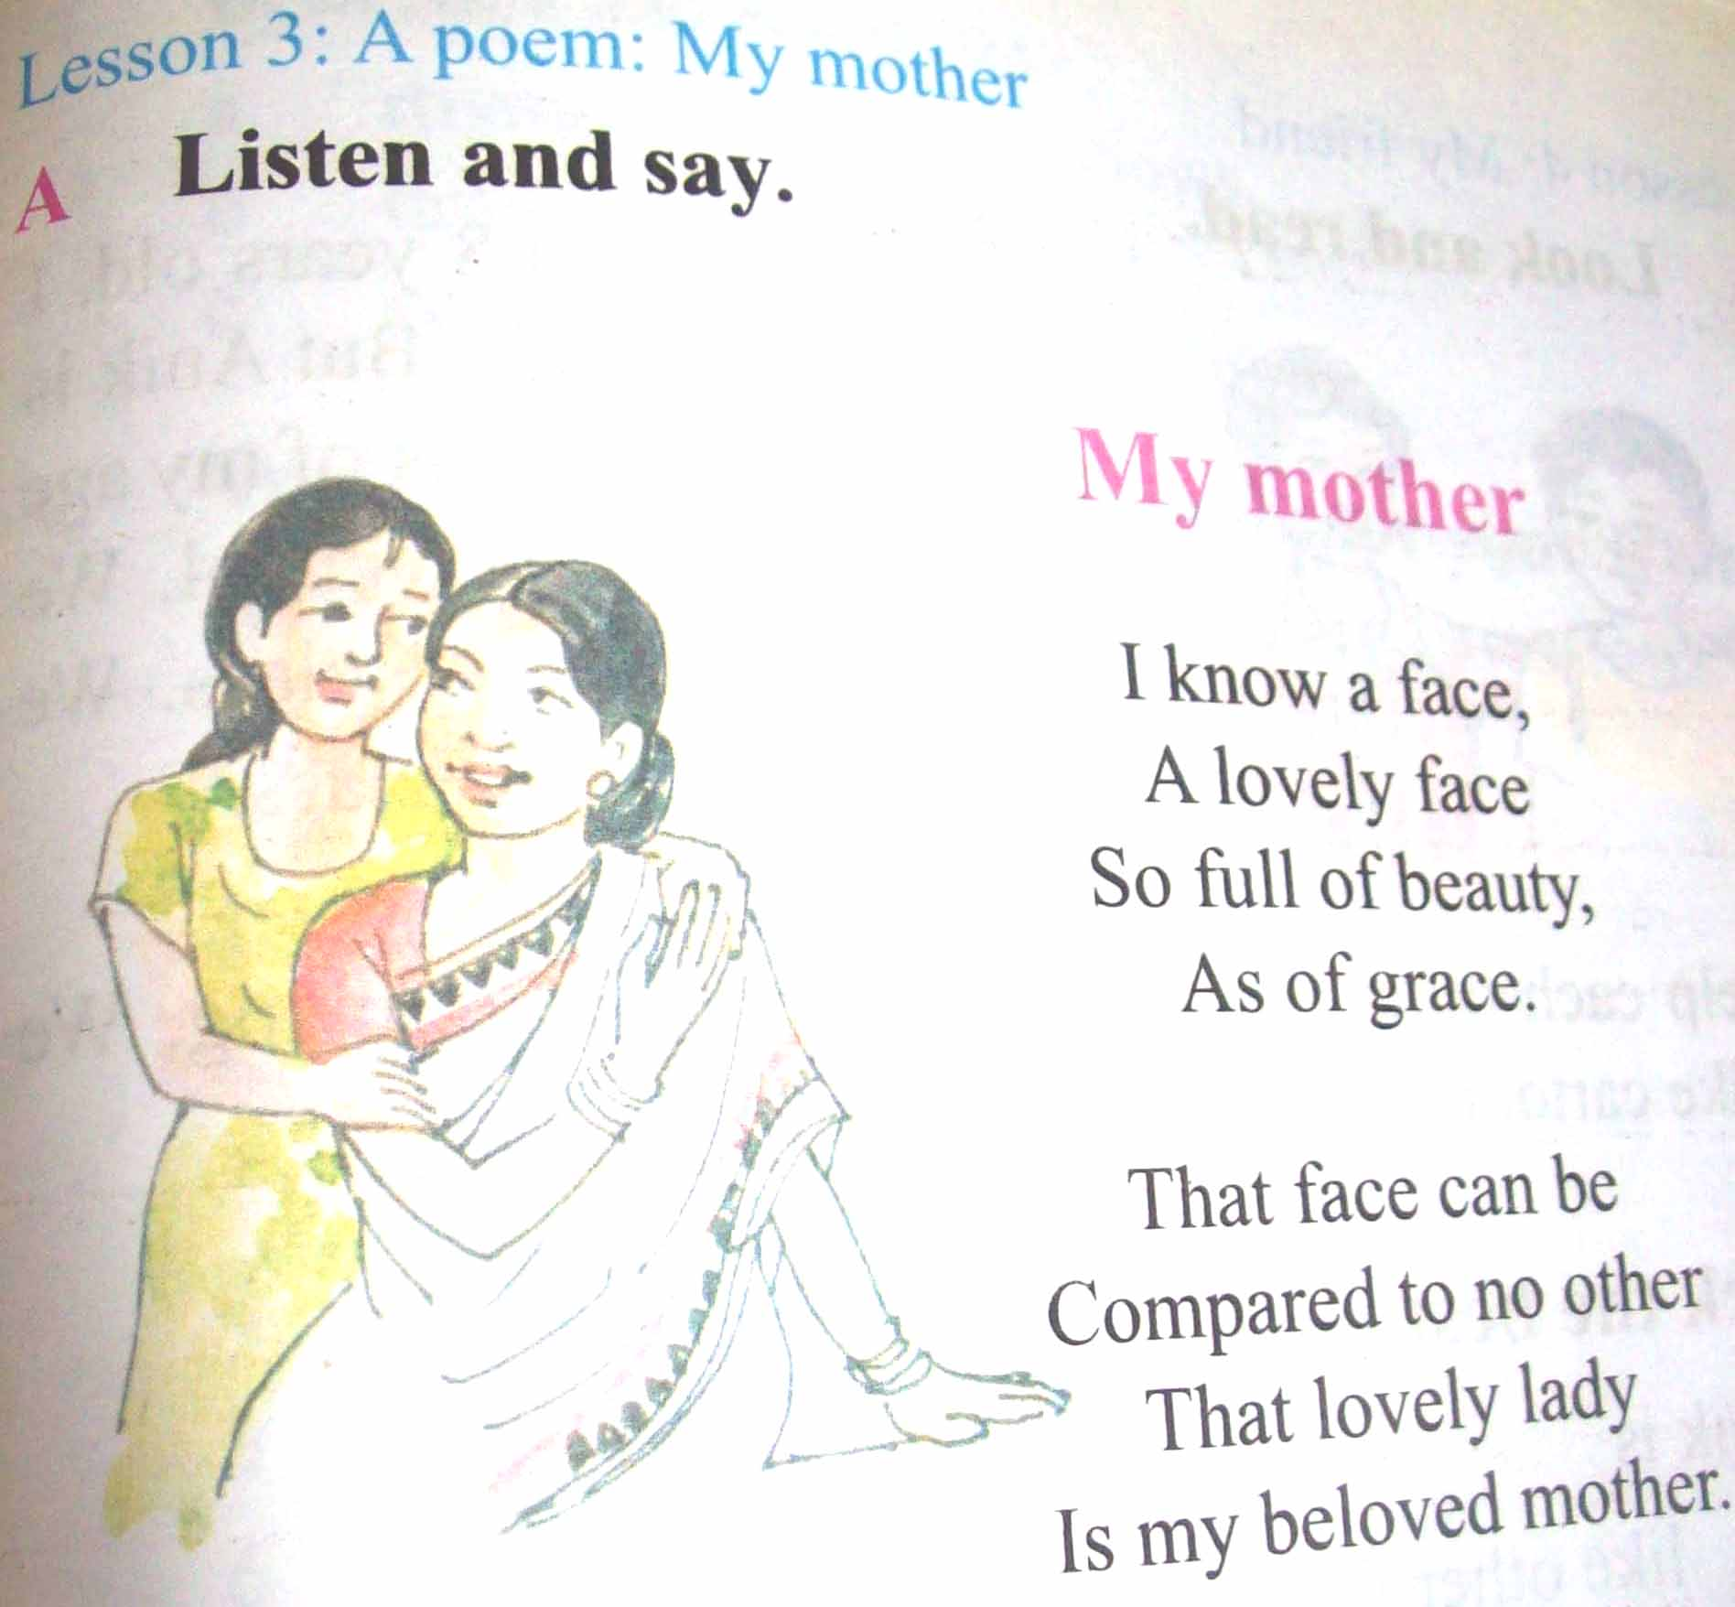
Open your book (page no :71 and read silently.

Slide 18
practice

Slide 19
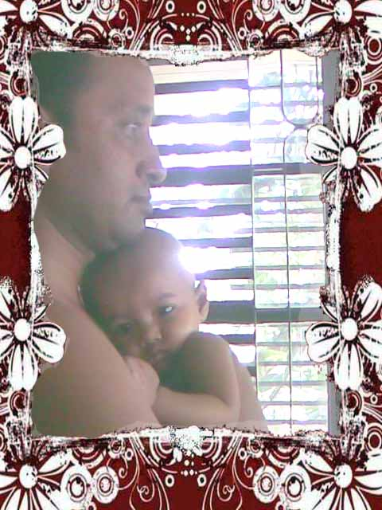
Group Work
Guess and say
Who is the the person ?
Brother/ uncle/ father
Whom you love most?
Mother/ father/sister

Slide 20
Pair Work
W
hich words tell you that your mother is beautiful
I know a face,
A lovely face
So full of beauty,
As a grace.
lovely
beauty

Slide 21
Individual work
Copy the lines.
What does your father do?
Grand mother tell us stories.

Slide 22
Evaluation
Green Group
Blue Group
Red Group
Write the rhyme.
Recite the rhyme.
Read the rhyme

Slide 23
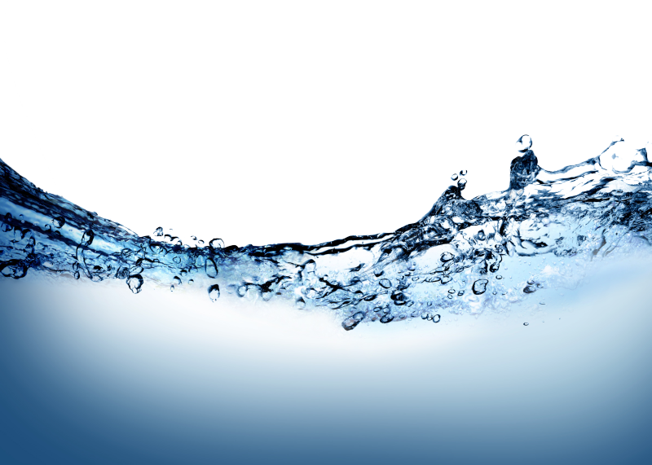





Home Task
Write 5 lines about your mother.

Slide 24

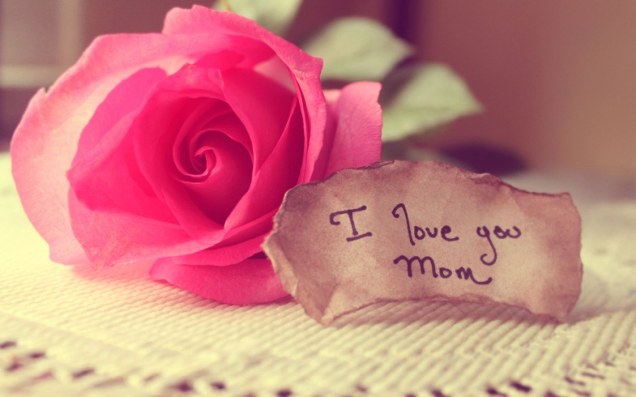
Closing of the Class
Stay
Fine
Thanks

